Slide 1


Reading Comprehension Question Answering System
老师：刘晋
小组成员：刘浩洋 蔡世鹏 史周胤 许润轩

Slide 2

Catalogue
Final Prodect Demo
Project Execution Detail
Risk Plan
Test Plan&Test Cases
Lesson Learnt
Conclusion&Future Plan For Next Cycle

Slide 3
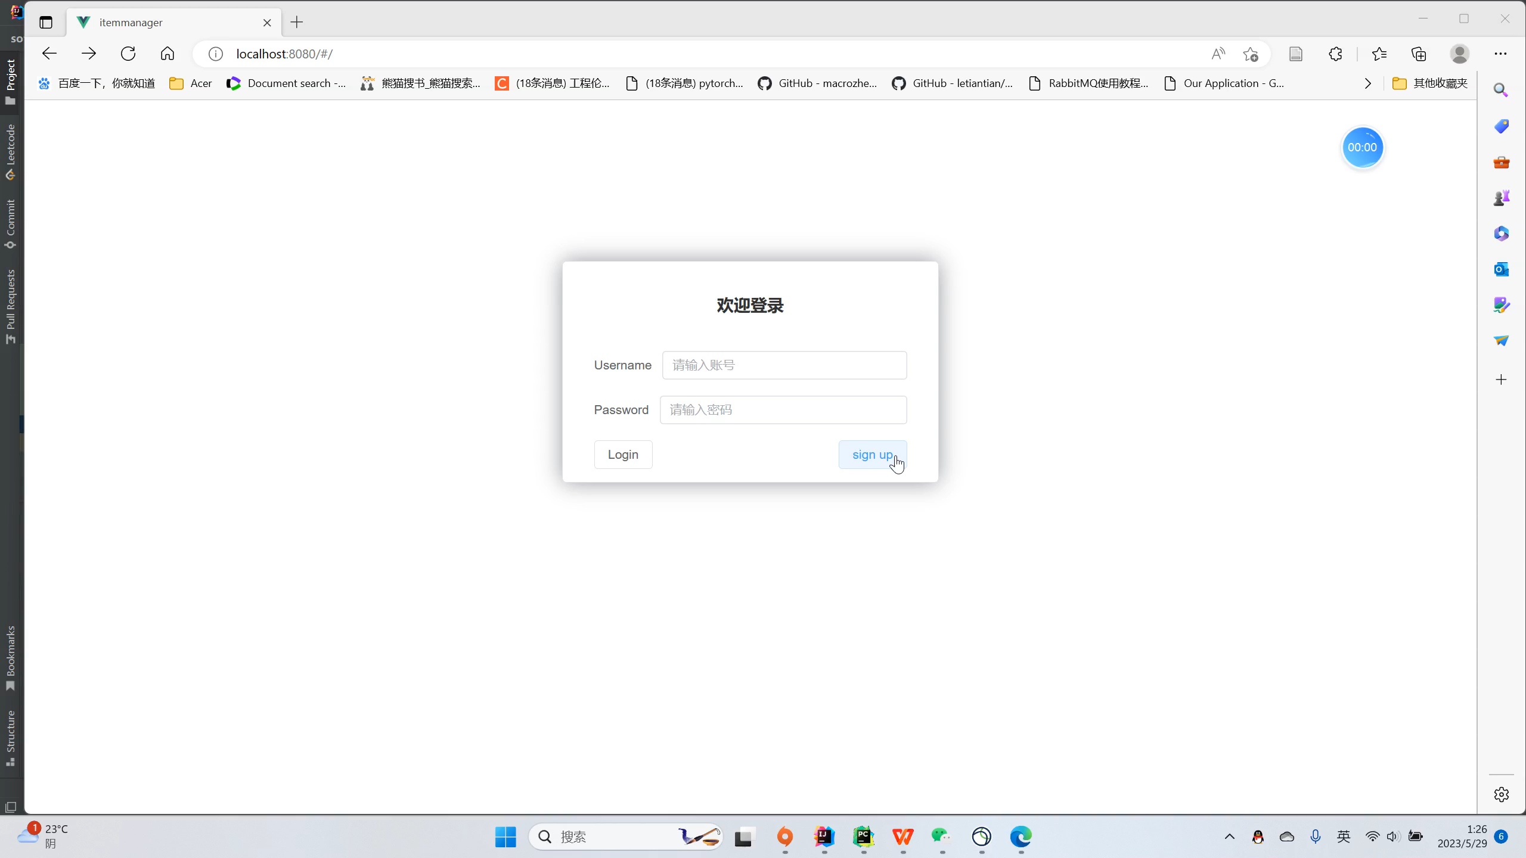
Demo
Signup
and
Login

Slide 4
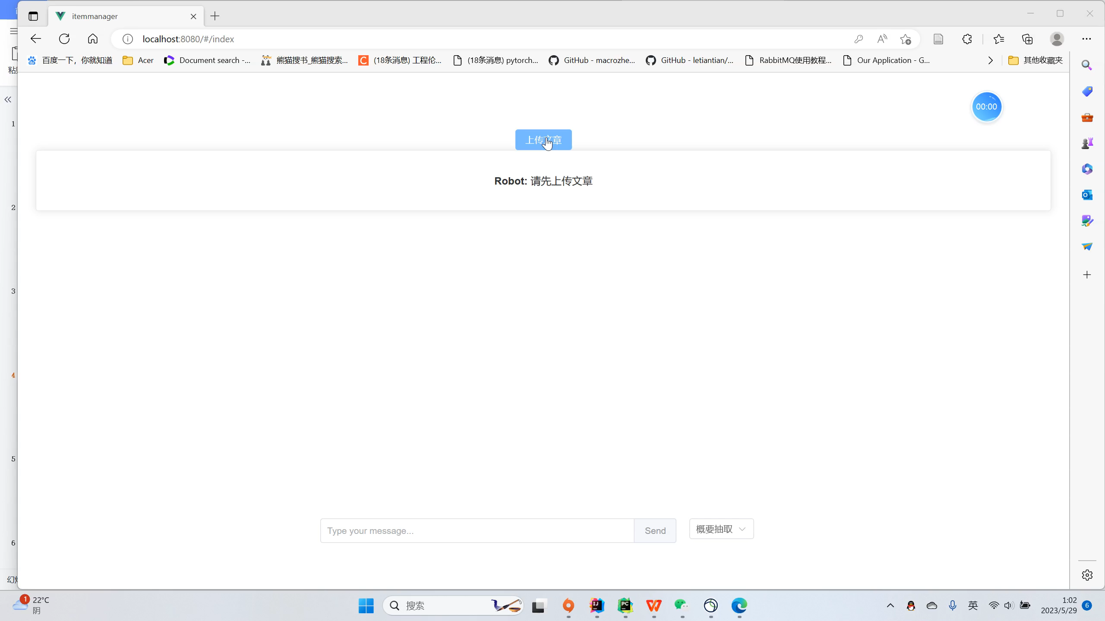
Demo
The Transformation
for
picture
to
text

Slide 5
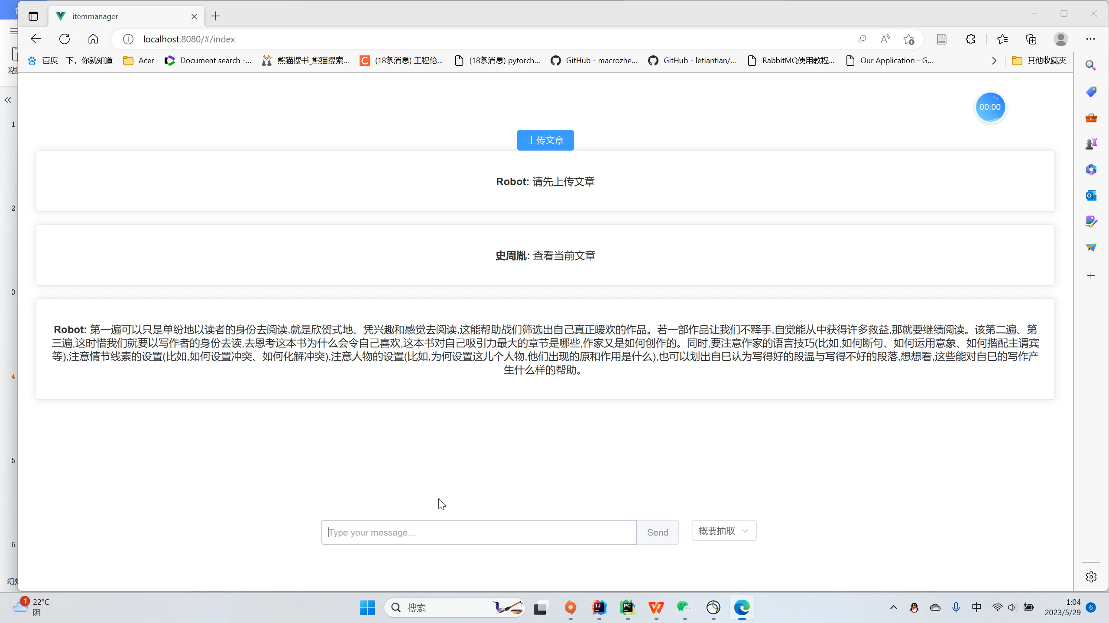
Demo
Summary
Extraction

Slide 6
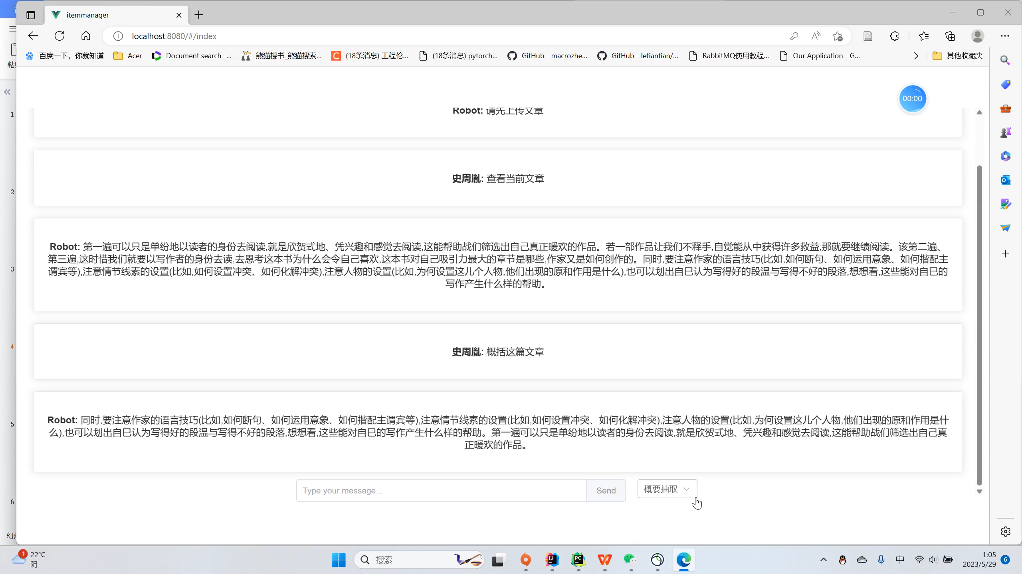
Demo
Machine
Learning
Comprehension

Slide 7
Execution
Detail
Project Progress
cost variance
schedule variance

Slide 8
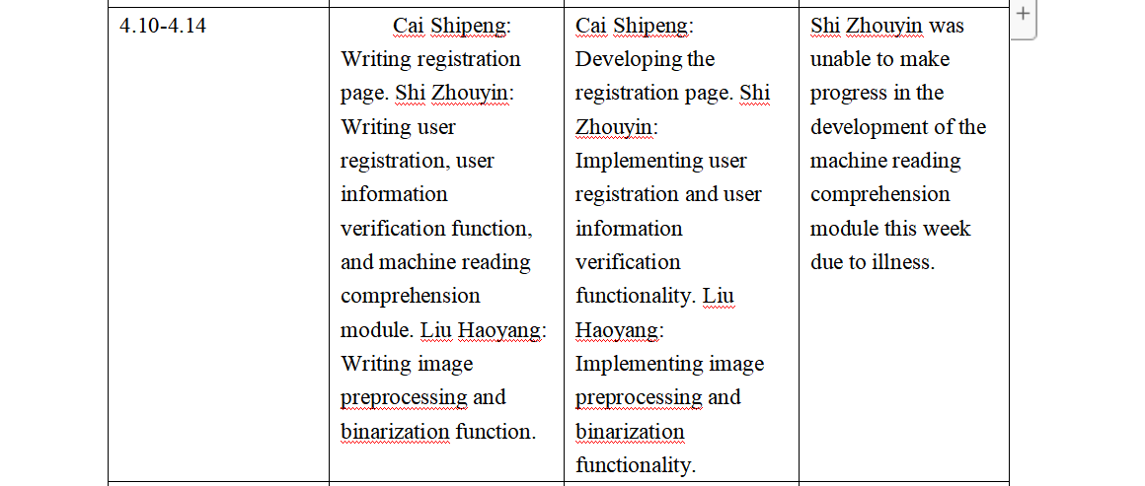
Execution
Detail
the cause of the varience
4.24-4.28 | Shi Zhouyin: Developing sentence segmentation and word segmentation functionality, and building collaborative matrix functionality. Liu Haoyang: Writing layout analysis, character segmentation, and character recognition modules. Cai Shipeng: Writing user interface for interaction between users and the backend. Xu Runxuan: Testing the results of each component. | Shi Zhouyin: Integrating frontend and backend for user login and registration functionality, and integrating the machine reading comprehension module with the backend. Liu Haoyang: Performing layout analysis and character segmentation. Cai Shipeng: Integrating frontend and backend for user login and registration functionality. Xu Runxuan: Testing the results of each component. | There were some issues with the integration of the frontend and backend for user login and registration functionality, which have been addressed and fixed this week. Additionally, Shi Zhouyin was unable to complete the development of the sentence segmentation and word segmentation functionality, as well as the collaborative matrix functionality, due to other coursework and assignments related to the end of the semester. The character recognition module and the article upload page were also not completed this week.

Slide 9
Execution
Detail
the solution of the varience
5.1-5.5 | Holiday | This week, Shi Zhouyin will be working on the development of the sentence segmentation and word segmentation functionality, as well as the collaborative matrix functionality. Liu Haoyang will be focusing on the character recognition module, and Cai Shipeng will be working on the article upload page. | Working overtime.

Slide 10
Risk Plan
Risk Indetification
RBS level 0 | RBS level 1 | RBS level 2
All risks probably happen in project | Technique Risk | low proficiency in technique
 |  | External Interface Risk
 | Manage Risk | Someone absent from the meeting
 |  | Underestimate of the workload and difficulties of a week
 |  | Cuurent plan is difficult to complete
 |  | Someone busy in their personal affairs
 | Accidental Risk | Someone get sick，recover in a week
 |  | The loss of current work
 |  | Someone get sick，recover for a long time

Slide 11
Risk Plan
Quantifying risk probability and impact
Project Objective | Very low/0.05 | Low/0.1 | Moderate/0.2 | High/0.4 | Very high/0.8
Time cost | Insignificant Time increase | 1 week time increase | 2 week time increase | 3 week time increase | 4 week time increase
Scope | Scope decrease barely noticeable | Minor areas of scope affected | Major areas of Scope affected | Scope reduction unacceptable to sponsor | Project end item is effectively useless
Quality | Quality degradation barely noticeable | Only very demanding applications are affected | Quality reduction requires sponsor approval | Quality reduction unacceptable to sponsor | Project end item effectively useless
Subjective Rating | Very low | Low | Moderate | High | Very high
Probabability | 0-0.10 | 0.11 -0.30 | 0.31-0.50 | 0.51-0.70 | 0.70-1.0

Slide 12
Risk Plan
Risk assessment
Probability | Threats
0.9 | 0.05 | 0.09 | 0.18 | 0.36 | 0.72
0.7 | 0.04 | 0.07 | 0.14 | 0.28 | 0.56
0.5 | 0.03 | 0.05 | 0.10 | 0.20 | 0.40
0.3 | 0.02 | 0.03 | 0.06 | 0.12 | 0.24
0.1 | 0.01 | 0.01 | 0.02 | 0.04 | 0.08
Impact | 0.05 | 0.1 | 0.2 | 0.4 | 0.8
Subjective Rating | Low-level Risk | Medium-level Risk | High-level risk
Threats | <0.05 | >0.05 and <0.1 | >0.1

Slide 13
Risk Plan
Risk assessment
Risk level | risk profile | Risk counter measures | Encounted?
Low level Risk | low proficiency in technique | Allocate time for learning and increase weekly working hours | √
 | Someone absent from the meeting | Agree on another time to hold the meeting | √
 | External Interface Risk | Find another useful Interface | ×
 | Someone busy in their personal affairs | increase weekly working hours | √
 | Current plan is difficult to complete | Change the project plan | ×
 | Someone get sick，recover in a week | increase weekly working hours or give their work to others | √
Medium level Risk | Someone get sick，recover for a long time | Find another one to replace him | ×
 | The loss of current work | Make backups for the project | ×
 | Underestimate of the workload and difficulties of a week | Postpone the commit time and increase weekly working hours | ×
Risk Profile | Probability | Impact | Threat
low proficiency in technique | 0.5 | 0.1 | 0.05
External Interface Risk | 0.1 | 0.05 | 0.01
Someone absent from the meeting | 0.5 | 0.1 | 0.05
Underestimate of the workload and difficulties of a week | 0.3 | 0.2 | 0.06
Current plan is difficult to complete | 0.1 | 0.4 | 0.04
Someone busy in their personal affairs | 0.5 | 0.1 | 0.05
Someone get sick，recover in a week | 0.5 | 0.1 | 0.05
The loss of current work | 0.1 | 0.8 | 0.08
Someone get sick，recover for a long time | 0.3 | 0.2 | 0.06

Slide 14
Test Plan
Test Content | Responsible Person | Date
Test login function | Xu Runxuan | 4.24-4.28
Test Content | Responsible Person | Date
Test pictureToText Function | Xu Runxuan | 5.24-5.28
Test Content | Responsible Person | Date
Test signup function | Xu Runxuan | 4.24-4.28
Test Content | Responsible Person | Date
Test Machine Reading Comprehension Function | Xu Runxuan Shi ZhouYin | 5.24-5.28
Test Content | Responsible Person | Date
Test Summary Function | Xu Runxuan Shi ZhouYin | 5.15-5.22
Test Content | Responsible Person | Date
Test Upload Function | Xu Runxuan Shi ZhouYin | 5.24-5.28

Slide 15
Test plan
Test tools:Testing with Spring Integration Junit
pass standard:
Test login function, Test signup function and Test Upload function:All Examples can input result equals to expected result
Test Summary Function, Test pictureToText Function,Test Machine Reading Comprehension Function:code can successfully run
Test Method:
Test login function, Test signup function and Test Upload function:we use legal and illegall inputs to test the code
Test Summary Function, Test pictureToText Function,Test Machine Reading Comprehension Function:we use variable input to test the code

Slide 16
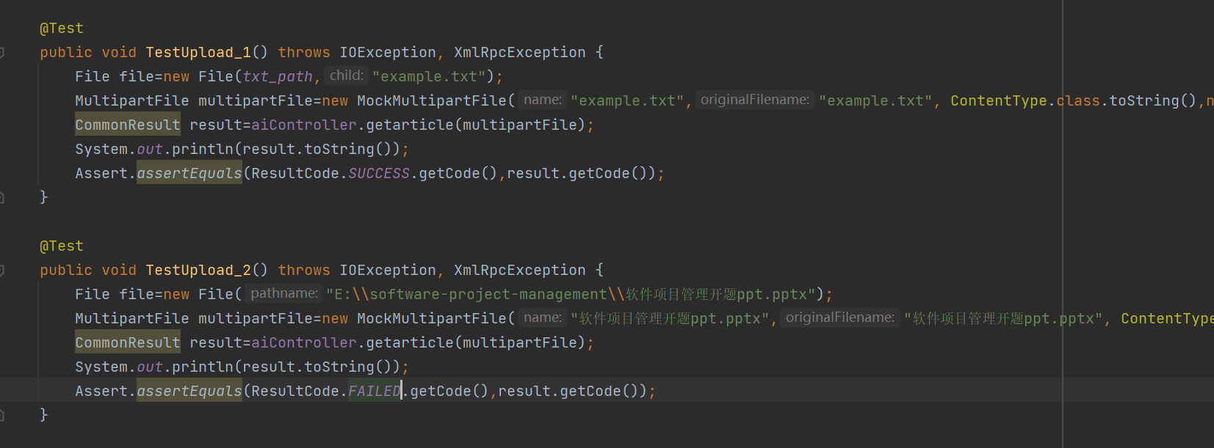

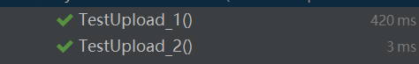
Test cases

Slide 17
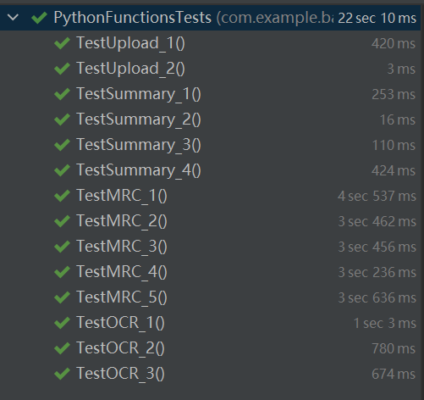
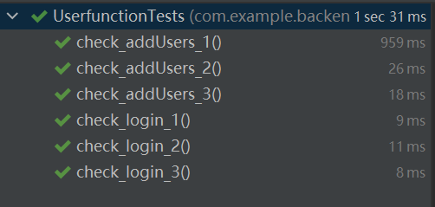
Test result

Slide 18
Lesson Learnt
1.Project management knowledge: Software project management enables us to master the basic knowledge and skills of project management, such as project scope management, schedule management, cost management, risk management and other aspects of knowledge, which is also applicable to managing other types of projects.
2.Teamwork: Software project management requires team members to work together to accomplish tasks. This helps improve our teamwork and communication skills, and makes us better able to cooperate with others to complete tasks.
3.Risk Management: In software project management, we need to assess and manage various risks in the project. This process brings new domain knowledge and risk management skills, while also allowing us to understand best practices for identifying and handling risks within a project.

Slide 19
Conclusion
We successfully completed the transformation of pictures to files, summary extraction, machine reading comprehension.all risks we have met are successfully resolved.
We realized all functions we have scheduled before without using exceeding time

Slide 20
Future plan to next cycle
1.Conduct more tests on code and fix the bugs
2.we intend to use more effective network to increase the accuracy of reading comprehension model
3.Add functions such as the transformation of audio to text.

